Slide 1
Computer Organization and Architecture
Lecture15 Pipeline-II
Jihe Wang
wangjihe@nwpu.edu.cn

Slide 2
Today’s Topic
00
01. Recap
02. Introduction of pipeline
03. Hazard
04. Design a pipeline processor
05. Summary

Slide 3
Recap: Summary of Pipelining Basics
1
5 stages:
Fetch: Fetch instruction from memory
Decode: get register values and decode control information
Execute: Execute arithmetic operations/calculate addresses
Memory: Do memory ops (load or store)
Writeback: Write results back to registers (I.e. COMMIT)
Pipelines pass control information down the pipe just as data moves down pipe
Forwarding/Stalls handled by local control
Balancing length of instructions makes pipelining much smoother
Increasing length of pipe increases impact of hazards; pipelining helps instruction bandwidth, not latency

Slide 4
Recap: Can pipelining get us into trouble?
1.1
Yes: Pipeline Hazards
structural hazards: attempt to use the same resource two different ways at the same time
E.g., combined washer/dryer would be a structural hazard or folder busy doing something else (watching TV)
data hazards: attempt to use item before it is ready
E.g., one sock of pair in dryer and one in washer; can’t fold until get sock from washer through dryer
instruction depends on result of prior instruction still in the pipeline
control hazards: attempt to make a decision before condition is evaulated
E.g., washing football uniforms and need to get proper detergent level; need to see after dryer before next load in
branch instructions
Can always resolve hazards by waiting
pipeline control must detect the hazard
take action (or delay action) to resolve hazards

Slide 5
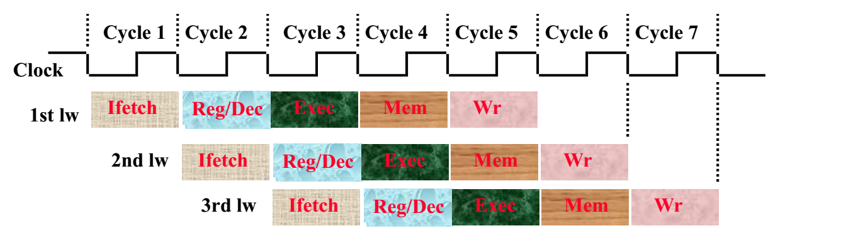
Pipelining the Load Instruction
1.2
The five independent functional units in the pipeline datapath are:
Instruction Memory for the Ifetch stage
Register File’s Read ports (bus A and busB) for the Reg/Dec stage
ALU for the Exec stage
Data Memory for the Mem stage
Register File’s Write port (bus W) for the Wr stage

Slide 6
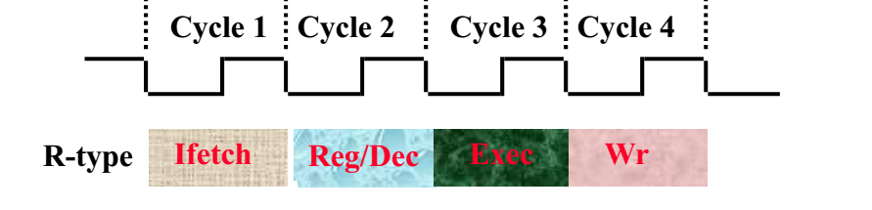
The Four Stages of R-type
Ifetch: Instruction Fetch
Fetch the instruction from the Instruction Memory
Reg/Dec: Registers Fetch and Instruction Decode
Exec:
ALU operates on the two register operands
Update PC
Wr: Write the ALU output back to the register file

Slide 7
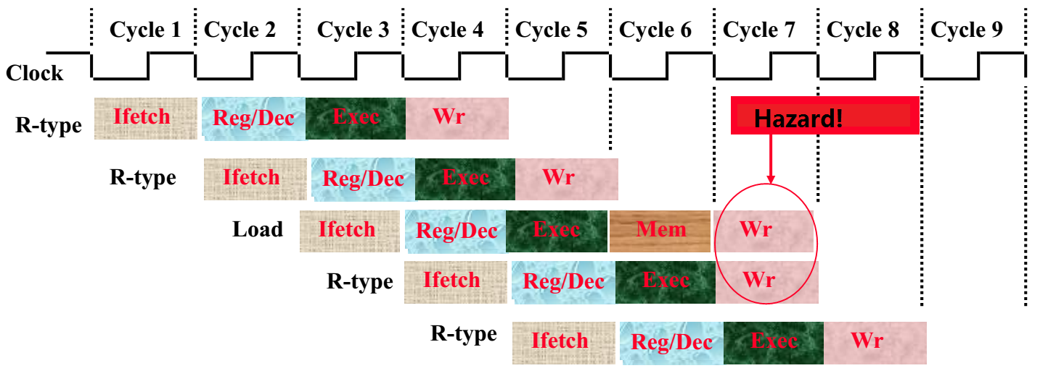
Pipelining the R-type and Load Instruction
2.1
We have a structural hazard:
Two instructions try to write to the register file at the same time!
Only one write port

Slide 8
Important Observation
2.2
Each functional unit can only be used once per instruction
Each functional unit must be used at the same stage for all instructions:
Load uses Register File’s Write Port during its 5th stage
R-type uses Register File’s Write Port during its 4th stage
1
2
3
4
5
Load
Ifetch
Reg/Dec
Exec
Mem
Wr
1
2
3
4
R-type
Ifetch
Reg/Dec
Exec
Wr
2 ways to solve this pipeline hazard.

Slide 9
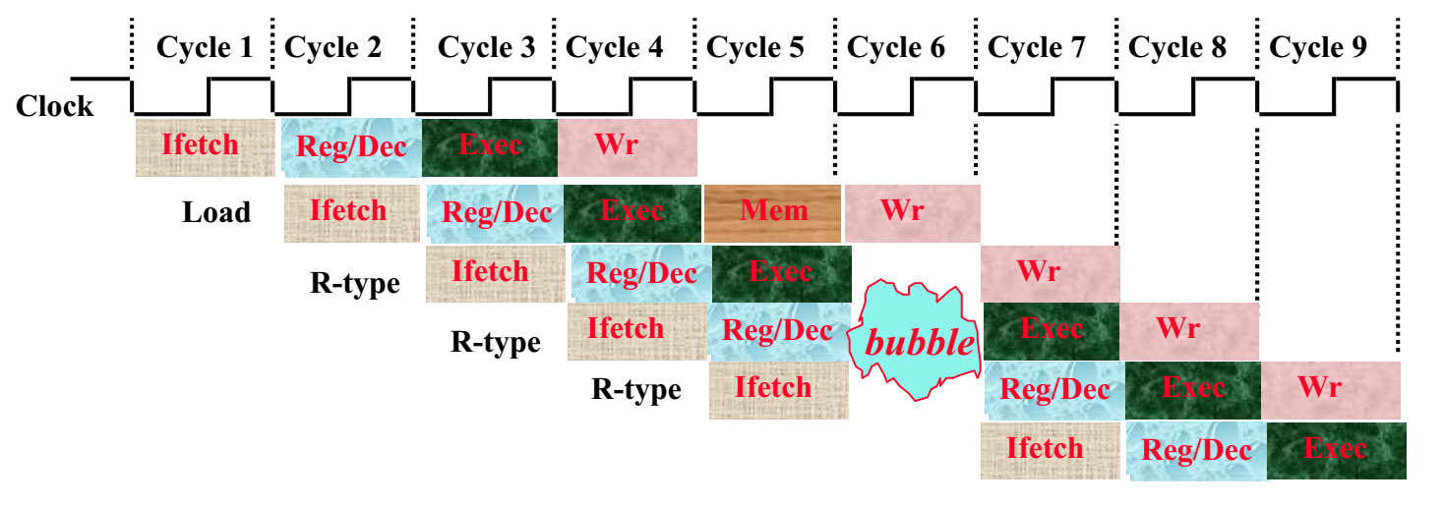
Solution 1: Insert “Bubble”
2.3
Insert a “bubble” into the pipeline to prevent 2 writes at the same cycle
The control logic can be complex.
Lose instruction fetch and issue opportunity.
No instruction is started in Cycle 6!

Slide 10
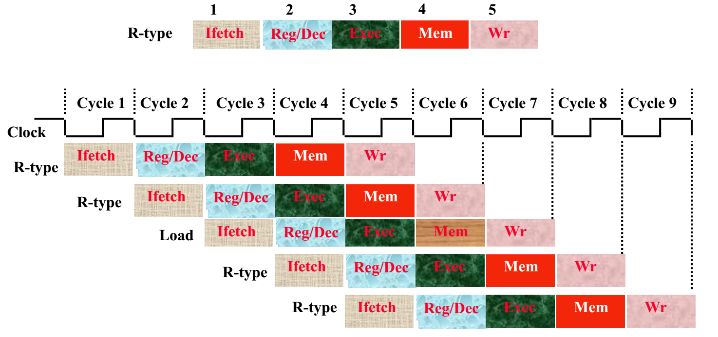
Solution 2: Delay R-type’s Write
2.4
Delay R-type’s register write by one cycle:
Now R-type instructions also use Reg File’s write port at Stage 5
Mem stage is a NOOP stage: nothing is being done.

Slide 11
Modified Control & Datapath
2.5
IR <- Mem[PC]; PC <– PC+4;
A <- R[rs]; B<– R[rt]
S <– A + B;
S <– A or ZX;
S <– A + SX;
S <– A + SX;
if Cond
PC <-PC+SX;
M <– S
M <– S
M <– Mem[S]
Mem[S] <- B
R[rd] <– M;
R[rt] <– M;
R[rd] <– M;
Equal
Reg.
File
Reg
File
A
S
M
Exec
PC
IR
Next PC
Inst. Mem
B
Mem
Access
Data
Mem
D

Slide 12
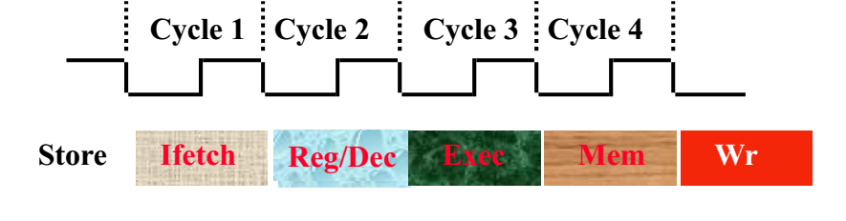
The Four Stages of Store
2.6
Ifetch: Instruction Fetch
Fetch the instruction from the Instruction Memory
Reg/Dec: Registers Fetch and Instruction Decode
Exec: Calculate the memory address
Mem: Write the data into the Data Memory

Slide 13
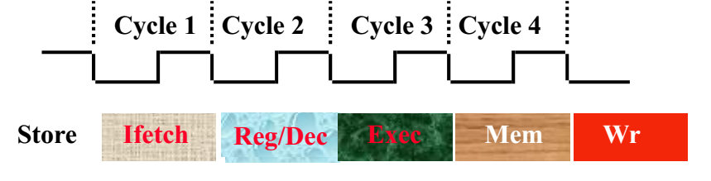
The Three Stages of Beq
2.7
Ifetch: Instruction Fetch
Fetch the instruction from the Instruction Memory
Reg/Dec:
Registers Fetch and Instruction Decode
Exec:
compares the two register operand,
select correct branch target address
latch into PC

Slide 14
Control Diagram
2.8
IR <- Mem[PC]; PC < PC+4;
A <- R[rs]; B<– R[rt]
S <– A + B;
S <– A or ZX;
S <– A + SX;
S <– A + SX;
If Cond PC < PC+SX;
M <– S
M <– S
M <– Mem[S]
Mem[S] <- B
R[rd] <– S;
R[rt] <– S;
R[rd] <– M;
Equal
Reg.
File
Reg
File
A
S
M
Exec
PC
IR
Next PC
Inst. Mem
B
Mem
Access
Data
Mem
D

Slide 15
The Big Picture: Where are We Now?
2.9
The Five Classic Components of a Computer
Processor
Input
Control
Memory
Datapath
Output

Slide 16
Recall: Single cycle control
2.10
Control
Ideal
Instruction
Memory
Instruction
Control Signals
Conditions
Rd
Rs
Rt
5
5
5
Instruction
Address
A
Data
Address
Rw
Ra
Rb
32
Data
Out
32
32
Ideal
Data
Memory
32 32-bit
Registers
ALU
PC
Next Address
Data In
B
Clk
32
Clk
Clk
Datapath

Slide 17
Data Stationary Control
2.11
The Main Control generates the control signals during Reg/Dec
Control signals for Exec (ExtOp, ALUSrc, ...) are used 1 cycle later
Control signals for Mem (MemWr Branch) are used 2 cycles later
Control signals for Wr (MemtoReg MemWr) are used 3 cycles later
Reg/Dec
Exec
Mem
Wr
ExtOp
ExtOp
ALUSrc
ALUSrc
ALUOp
ALUOp
Main
Control
RegDst
RegDst
IF/ID Register
ID/Ex Register
Ex/Mem Register
Mem/Wr Register
MemWr
MemWr
MemWr
Branch
Branch
Branch
MemtoReg
MemtoReg
MemtoReg
MemtoReg
RegWr
RegWr
RegWr
RegWr

Slide 18
Datapath + Data Stationary Control
2.12
IR
v
v
v
fun
rw
rw
rw
wb
wb
wb
Inst. Mem
Decode
me
me
WB
Ctrl
rt
Mem
Ctrl
rs
ex
op
rs
rt
im
Reg.
File
Reg
File
A
S
M
Exec
B
Mem
Access
Data
Mem
D
Next PC
PC

Slide 19
Let’s Try it Out
2.13
10 lw r1, r2(35)
14 addI r2, r2, 3
20 sub r3, r4, r5
24 beq r6, r7, 100
30 ori r8, r9, 17
34 add r10, r11, r12
100 and r13, r14, 15
these addresses are octal

Slide 20
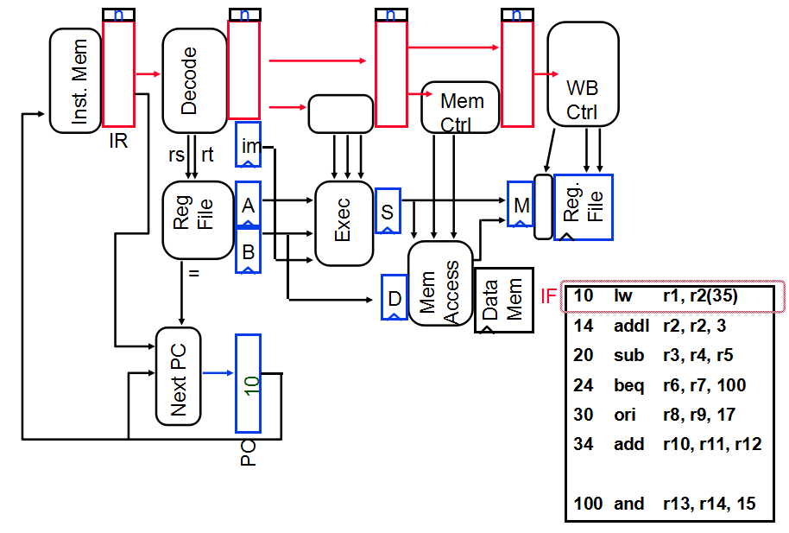
Start: Fetch 10
00

Slide 21
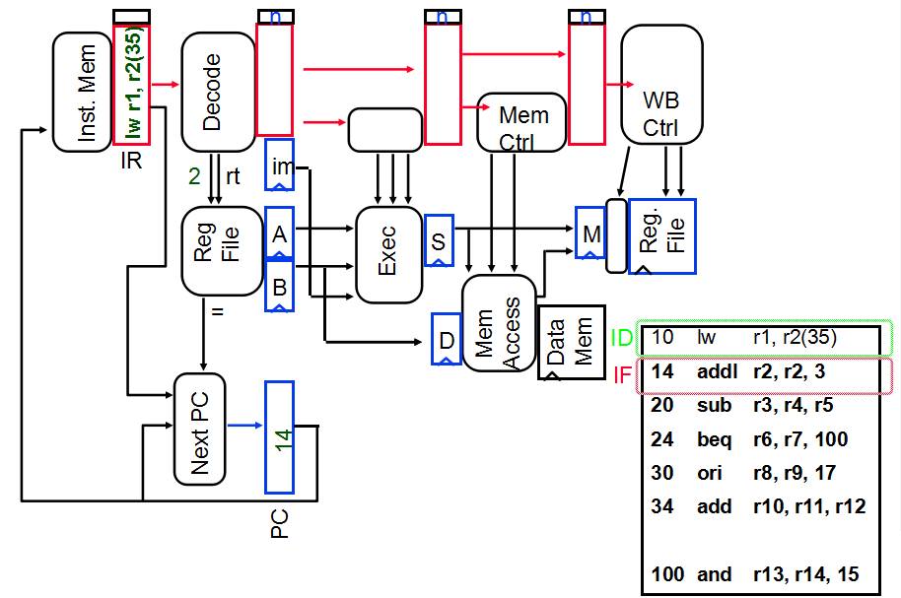
Fetch 14, Decode 10

Slide 22
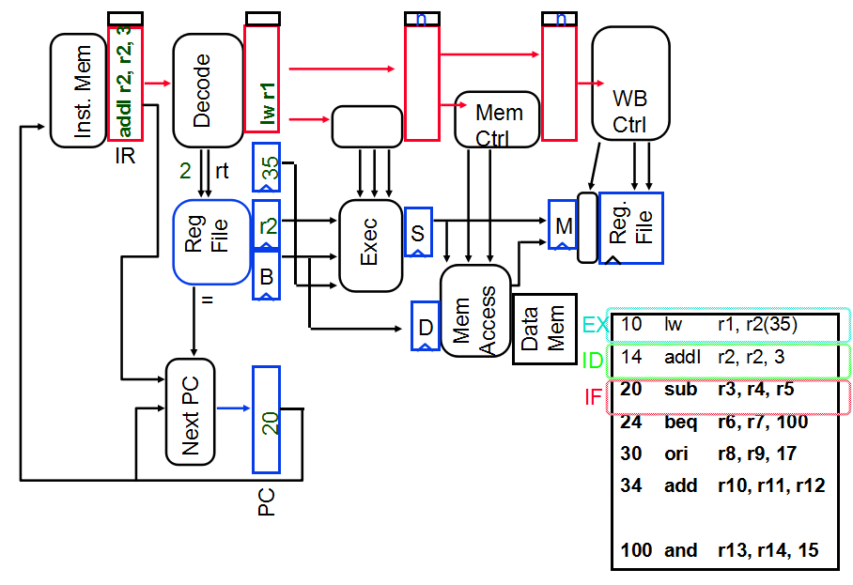
Fetch 20, Decode 14, Exec 10
3.2

Slide 23
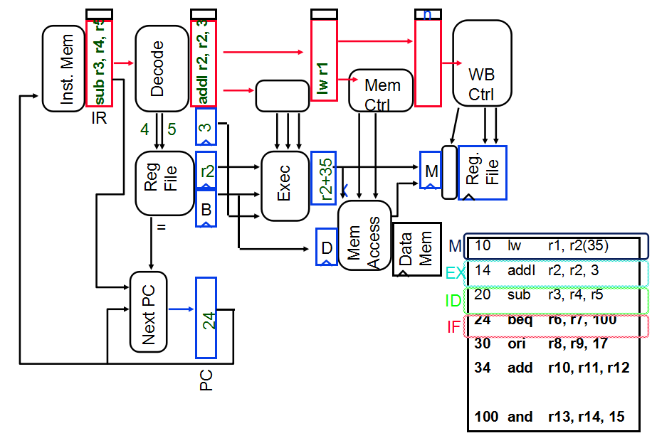
Fetch 24, Decode 20, Exec 14, Mem 10
3.3

Slide 24
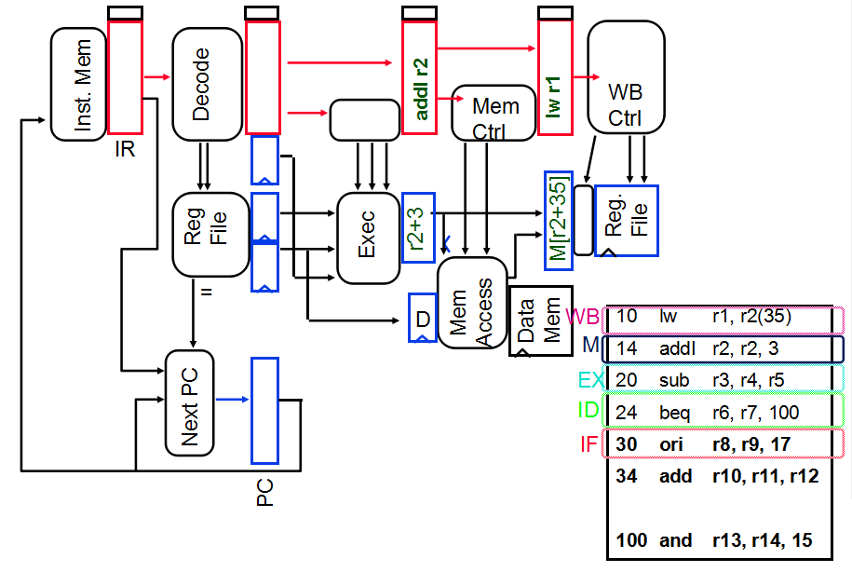
Fetch 30, Dcd 24, Ex 20, Mem 14, WB 10
3.4

Slide 25
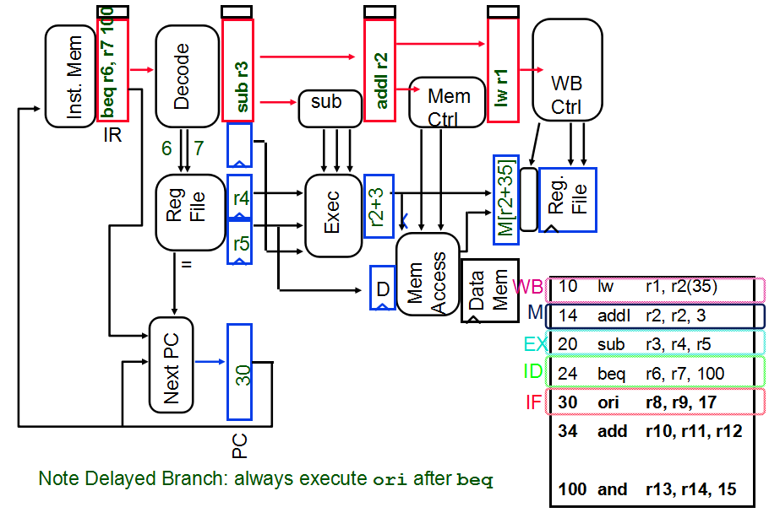
Fetch 30, Dcd 24, Ex 20, Mem 14, WB 10
3.5

Slide 26
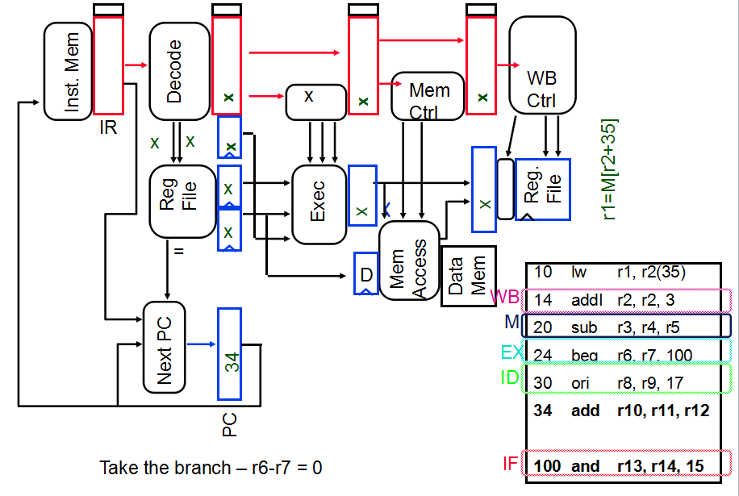
Fetch 34, Dcd 30, Ex 24, Mem 20, WB 14
3.6

Slide 27
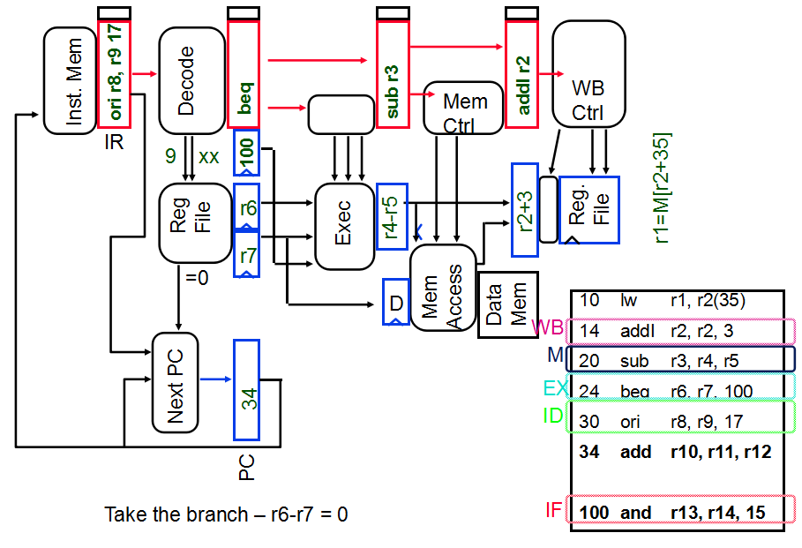
Fetch 34, Dcd 30, Ex 24, Mem 20, WB 14
3.7

Slide 28
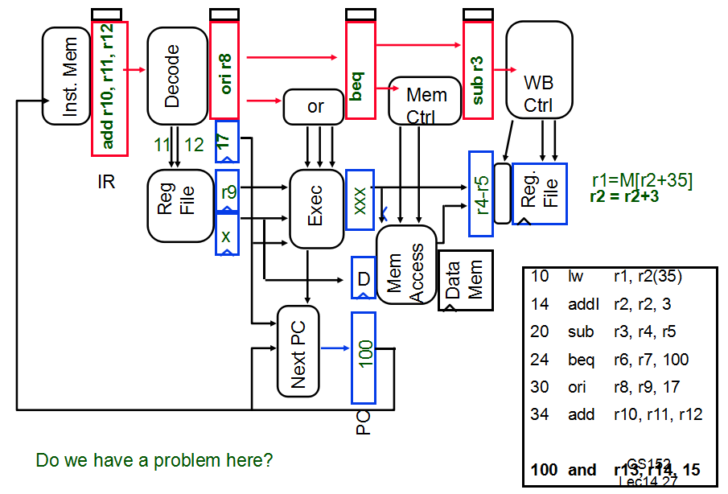
Fetch 100, Dcd 34, Ex 30, Mem 24, WB 20
3.8

Slide 29
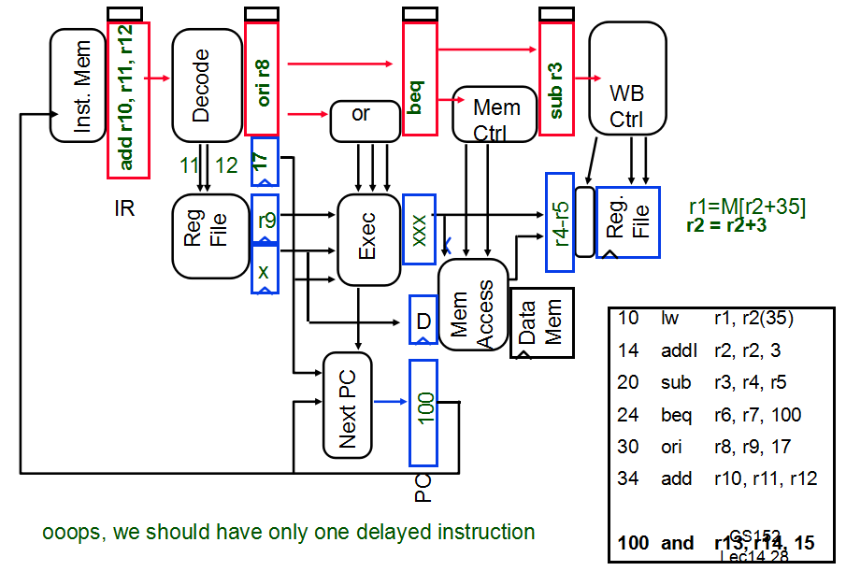
Fetch 100, Dcd 34, Ex 30, Mem 24, WB 20
3.9

Slide 30
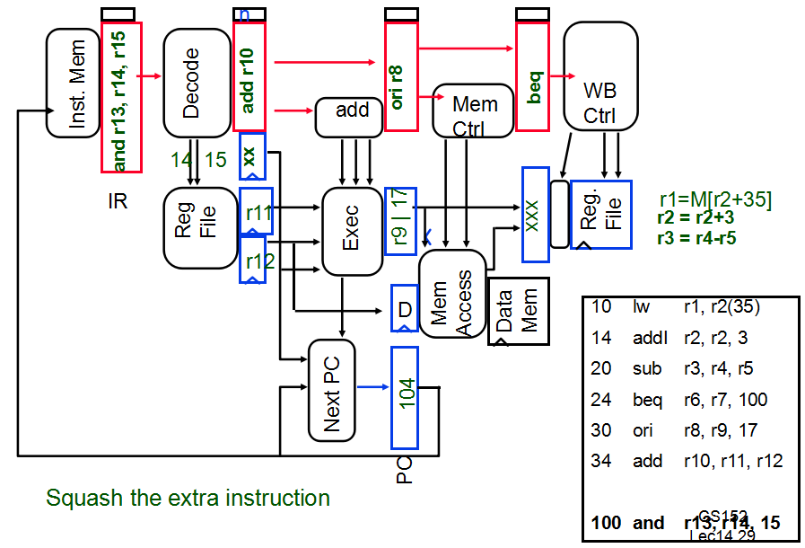
Fetch 104, Dcd 100, Ex 34, Mem 30, WB 24
3.10

Slide 31
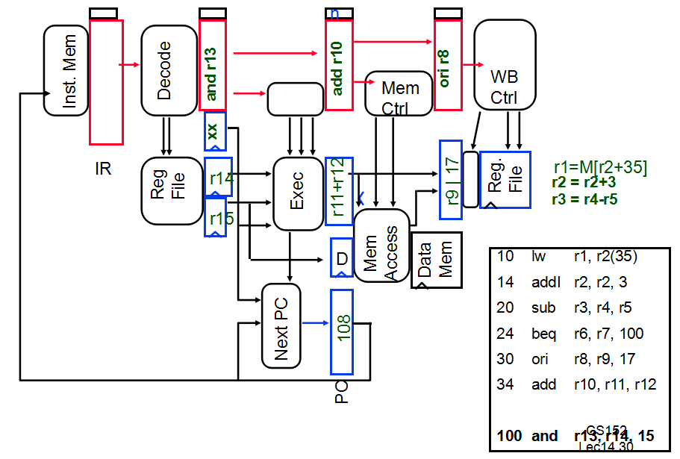
Fetch 108, Dcd 104, Ex 100, Mem 34, WB 30
3.11

Slide 32
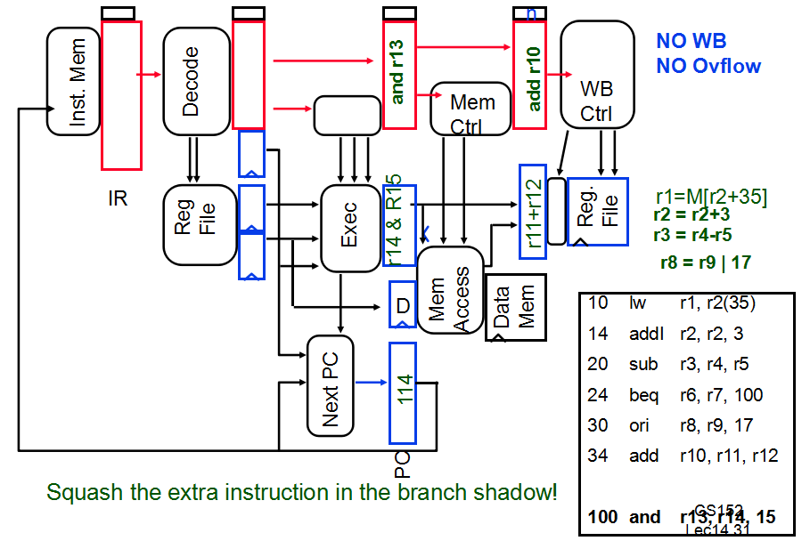
Fetch 112, Dcd 108, Ex 104, Mem 100, WB 34
3.12

Slide 33
Pipelined Processor
3.13
Bubbles
Valid
Stalls
IR
IRex
IRwb
Inst. Mem
Dcd Ctrl
Ex Ctrl
IRmem
Mem Ctrl
WB Ctrl
Equal
Reg.
File
Reg
File
A
S
Exec
PC
Next PC
B
Mem
Access
M
D
Data
Mem
Separate control at each stage
Stalls propagate backwards to freeze previous stages
Bubbles in pipeline introduced by placing “Noops” into local stage, stall previous stages.

Slide 34
Pipeline Hazards Again
3.14
I-Fetch DCD OpFetch Exec Store
IFetch DCD ° ° °
Structural
Hazard
I-Fet ch DCD OpFetch Jump
Control Hazard
IFetch DCD ° ° °
IF DCD EX Mem WB
RAW (read after write) Data Hazard
IF DCD EX Mem WB
WAW Data Hazard (write after write)
IF DCD EX Mem WB
IF DCD OF Ex Mem
IF DCD OF Ex RS
WAR Data Hazard (write after read)

Slide 35
Hazard Detection
00
Suppose instruction i is about to be issued and a predecessor instruction j is in the instruction pipeline.
A RAW hazard exists on register ρ if ρ ∈ Rregs( i ) ∩ Wregs( j )
Keep a record of pending writes (for inst's in the pipe) and compare with operand regs of current instruction.
When instruction issues, reserve its result register as a write reservation.
When on operation completes, remove its write reservation.
A WAW hazard exists on register ρ if ρ ∈ Wregs( i ) ∩ Wregs( j )
A WAR hazard exists on register ρ if ρ ∈ Wregs( i ) ∩ Rregs( j )
New Inst
Inst I
Window on execution:
Only pending instructions can
cause exceptions
Instruction
Movement:
Inst J

Slide 36
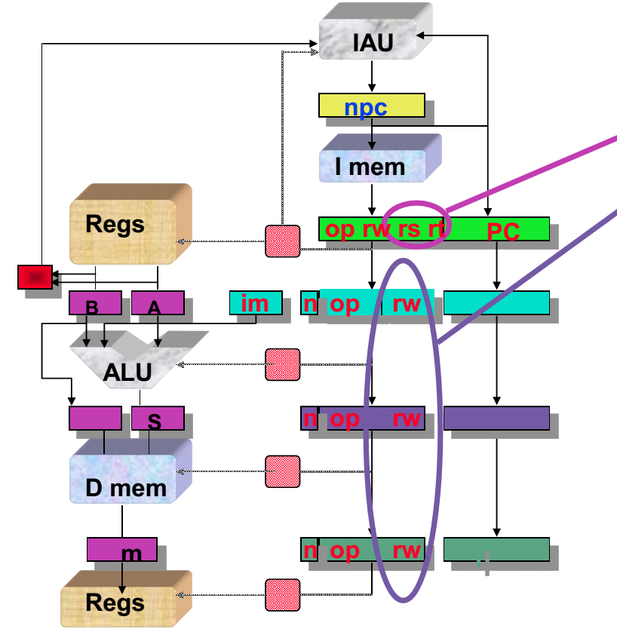
Record of Pending Writes In Pipeline Regs
Current operand registers
Pending writes
hazard <=
((rs == rw_{ex)} & regW_{ex}) OR
((rs == rw_{mem)} & regW_{me}) OR
((rs == rw_{wb)} & regW_{wb}) OR
((rt == rw_{ex)} & regW_{ex}) OR
((rt == rw_{mem)} & regW_{me}) OR
((rt == rw_{wb}) & regW_{wb})

Slide 37
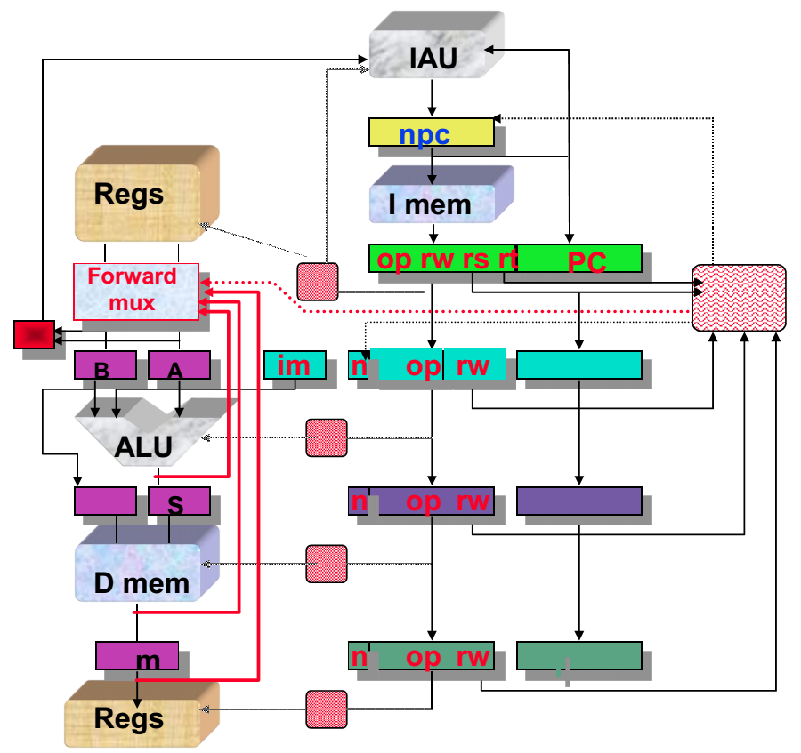
Resolve RAW by “forwarding”
4.1
Detect nearest valid write op operand register and forward into op latches, bypassing remainder of the pipe
Increase muxes to add paths from pipeline registers
Data Forwarding = Data Bypassing

Slide 38
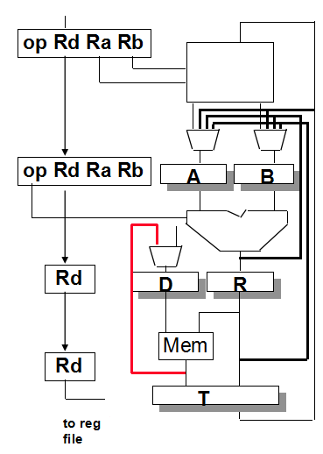
What about memory operations?
4.2
If instructions are initiated in order and operations always occur in the same stage, there can be no hazards between memory operations!
What about data dependence on loads? R1 <- R4 + R5 R2 <- Mem[ R2 + I ] R3 <- R2 + R1 ⇒ “Delayed Loads”
Can recognize this in decode stage and introduce bubble while stalling fetch stage
Tricky situation: R1 <- Mem[ R2 + I ] Mem[R3+34] <- R1 Handle with bypass in memory stage!

Slide 39
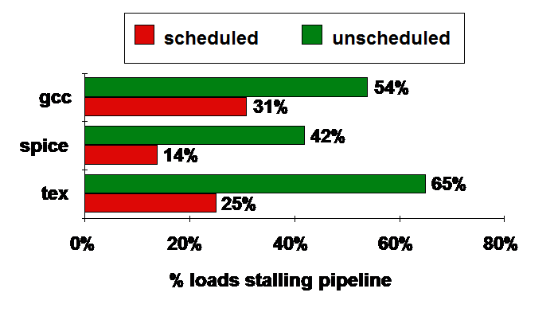
Compiler Avoiding Load Stalls:
4.3

Slide 40
What about Interrupts, Traps, Faults?
4.4
External Interrupts:
Allow pipeline to drain, Fill with NOPs
Load PC with interrupt address
Faults (within instruction, restartable)
Force trap instruction into IF
disable writes till trap hits WB
must save multiple PCs or PC + state
Recall: Precise Exceptions ⇒ State of the machine is preserved as if program executed up to the offending instruction
All previous instructions completed
Offending instruction and all following instructions act as if they have not even started
Same system code will work on different implementations

Slide 41
Exception/Interrupts: Implementation questions
4.5
5 instructions, executing in 5 different pipeline stages!
Who caused the interrupt?
Stage Problem interrupts occurring
IF Page fault on instruction fetch; misaligned memory access; memory-protection violation
ID Undefined or illegal opcode
EX Arithmetic exception
MEM Page fault on data fetch; misaligned memory access; memory-protection violation; memory error
How do we stop the pipeline? How do we restart it?
Do we interrupt immediately or wait?
How do we sort all of this out to maintain preciseness?

Slide 42
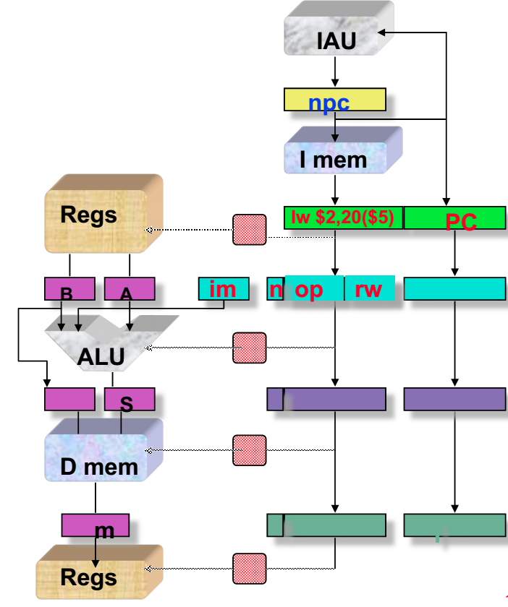
Exception Handling
4.6
detect bad instruction address
detect bad instruction
detect overflow
detect bad data address
Allow exception to take effect

Slide 43
Another look at the exception problem
4.7
Time
Data TLB
IFetch
Dcd
Exec
Mem
WB
Bad Inst
IFetch
Dcd
Exec
Mem
WB
Inst TLB fault
IFetch
Dcd
Exec
Mem
WB
Program Flow
Overflow
IFetch
Dcd
Exec
Mem
WB
Use pipeline to sort this out!
Pass exception status along with instruction.
Keep track of PCs for every instruction in pipeline.
Don’t act on exception until it reaches WB stage
Handle interrupts through “faulting no-op” in IF stage
When instruction reaches end of MEM stage:
Save PC ⇒ EPC, Interrupt vector addr ⇒ PC
Turn all instructions in earlier stages into no-ops!

Slide 44
Resolution: Freeze above & Bubble Below
4.8
IAU
npc
I mem
freeze
Regs
op rw rs rt
PC
bubble
B
A
im
n
op
rw
alu
S
n
op
rw
Flush accomplished by setting “invalid” bit in pipeline
D mem
m
n
op
rw
Regs

Slide 45
Summary
5
Hazards limit performance
Structural: need more HW resources
Data: need forwarding, compiler scheduling
Control: early evaluation & PC, delayed branch, prediction
Data hazards must be handled carefully:
RAW data hazards handled by forwarding
WAW and WAR hazards don’t exist in 5-stage pipeline
MIPS I instruction set architecture made pipeline visible (delayed branch, delayed load)
Exceptions in 5-stage pipeline recorded when they occur, but acted on only at WB (end of MEM) stage
Must flush all previous instructions
More performance from deeper pipelines, parallelism

Slide 46
Summary
5
Hazards limit performance
Structural: need more HW resources
Data: need forwarding, compiler scheduling
Control: early evaluation & PC, delayed branch, prediction
Data hazards must be handled carefully:
RAW data hazards handled by forwarding
WAW and WAR hazards don’t exist in 5-stage pipeline
MIPS I instruction set architecture made pipeline visible (delayed branch, delayed load)
More performance from deeper pipelines, parallelism

